Slide 1

Top End Code
New Zealand’s #1 Online Book & E-book Marketplace

Slide 2
700 Homepage lands per hour
Why sell through us?
300000 monthly hits and growing
700 Homepage lands per hour
A growing demand for IT resources
A growing demand specialised knowledge

Slide 3
Scenarios
Browse and Search Listings
Research Top End Code
Create Account
List Item(s)
Buy Items(s)
Leverage Business Sales
Create Brand Awareness
Advertise Your Company
Research Brand Awareness

Slide 4
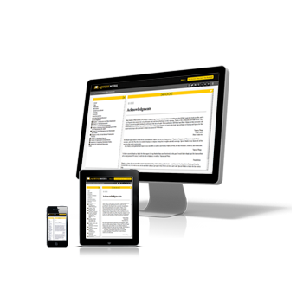
Top End Code
Thank you

